Slide 1

Major Project PG-DBDA
“Human Activity Recognition”
Guided By-
Ms. Saruti Gupta
Group Member-
Anokha Vinay Tigga
Mayank Agrawal
PG-DBDA (sep,2023)

Slide 2
Introduction-
As we are aware of the fact that in the previous decade huge amount of data generated by internet, social media(twitter, Facebook, Instagram) etc. in the format of images, video, text messages Peta byte of data had been generated.
So, the upcoming dedicated to the Sensor based data –
SENSOR BASED DATA- The term sensor data emphasizes the data source and the method of data collection where data comes from sensors.
Sensor data is generated when a device detects and responds to some type of input from the physical environment.

Slide 3
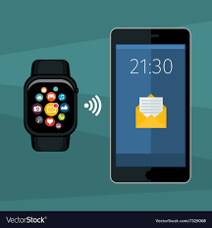
Smartphones and Smartwatch are the major source of data collection which detects the human activities.

Slide 4
Problem Statement-
Smart phones and other personal tracking devices used for fitness and health monitoring are cheap and ubiquitous. As such, sensor data from these devices is cheaper to collect, more common, and therefore is a more commonly studied version of the general activity recognition problem.
The problem is to predict the activity given a snapshot of sensor data, typically data from one or a small number of sensor types.

Slide 5
It is a challenging problem as there are no obvious or direct ways to relate the recorded sensor data to specific human activities and subject may perform an activity with significant variation, resulting in variations in the recorded sensor data.
The intent is to record sensor data and corresponding activities for specific subjects, fit a model from this data, and generalize the model to classify the activity of new unseen subjects from their sensor data.

Slide 6
Sensor data used
Accelerometer and Gyroscope
Accelerometers detect magnitude and direction of the proper acceleration, as a vector quantity, and can be used to sense orientation.
Gyroscope maintains orientation along a axis so that the orientation is unaffected by tilting or rotation of the mounting, according to the conservation of angular momentum.

Slide 7
DATASET
The data is split into 4 files in total divided by device (phone or watch) and sensor (gyroscope and accelerometer). The files for phones are: phones_accelerometer.csv, phones_gyroscope.csv for the accelerometer and gyroscope respectively, and for the watch_accelerometer.csv, watch_gyroscope.csv for the accelerometer and gyroscope as well. activities: ‘biking’, ‘sitting’, ‘standing’, ‘walking’, ‘stair up’ and ‘stair down’.
Sensors: two embedded sensors, i.e., accelerometer and gyroscope sampled at the highest frequency possible by the device Devices:
4 smartwatches (2 lg watches, 2 Samsung galaxy gears) 8 smartphones (2 Samsung galaxy s3 mini, 2 Samsung galaxy s3, 2 LG nexus 4, 2 Samsung galaxy s+) recordings: 9 users currently named: a, b, c, d, e, f, g, h, i consistently across all files.

Slide 8
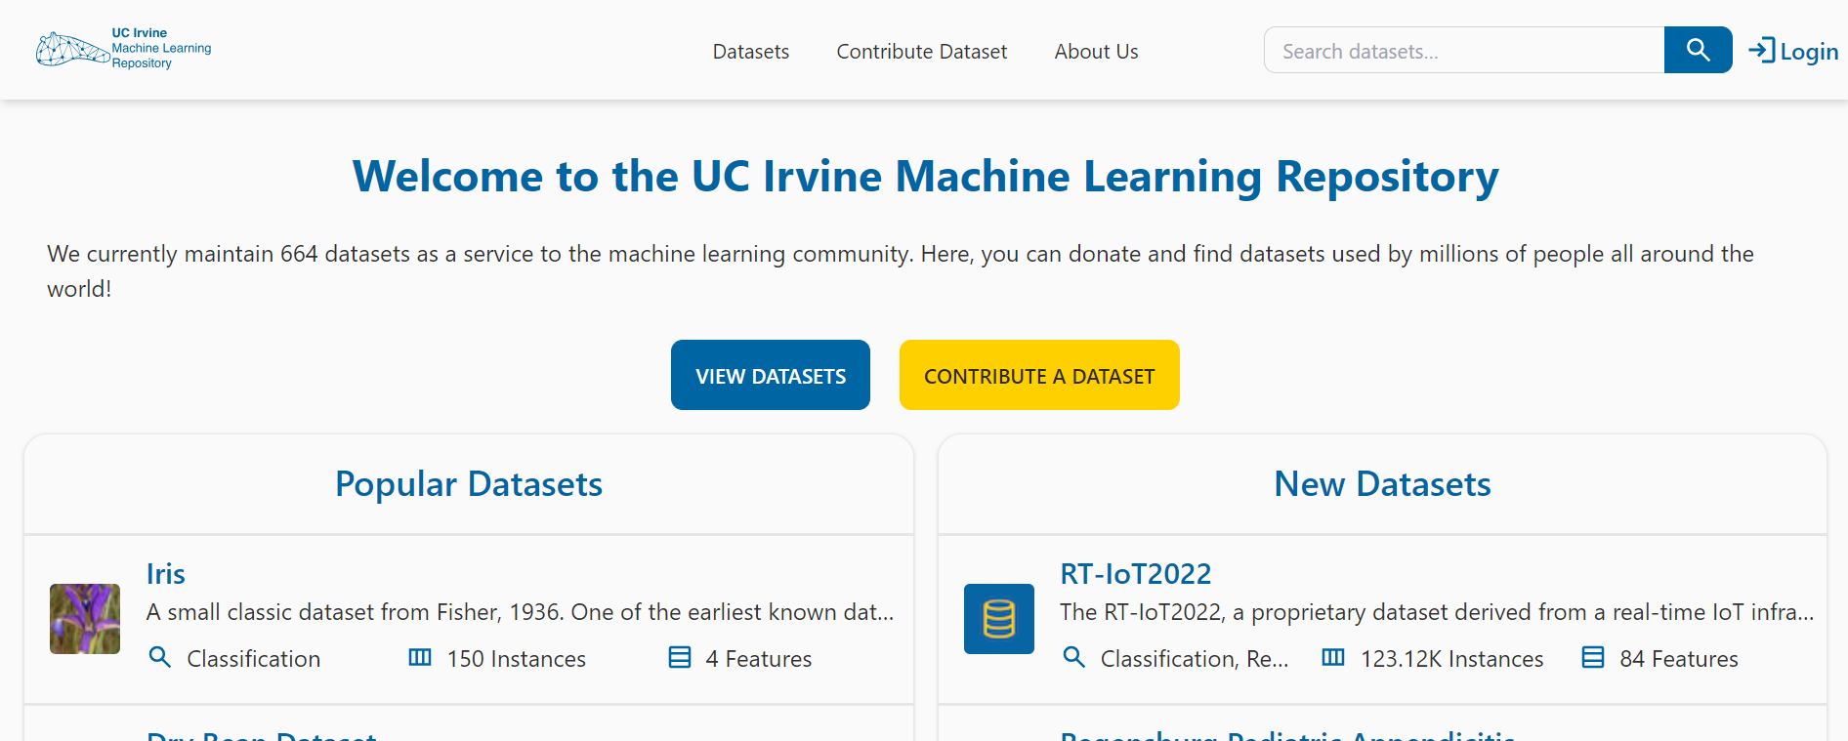

Slide 9
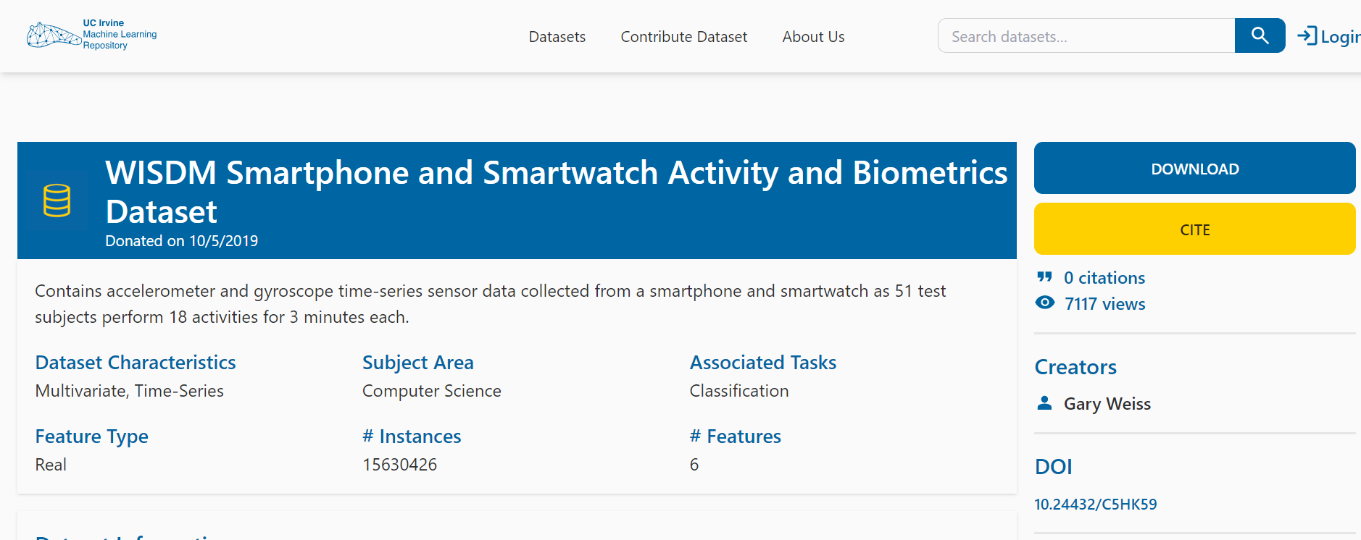
Dataset Retrieval

Slide 10
The data set is structured in the following way:
All the csv files have the same structure of following columns: 'index', 'arrival_time', 'creation_time', 'x', 'y', 'z', 'user', 'model', 'device', 'gt' And the columns have the following values:
Index: is the row number.
arrival_time: the time the measurement arrived to the sensing application creation_time : the timestamp the os attaches to the sample x,y,z :
The values provided by the sensor for the three axes, x,y,z
User: the user this sample originates from, the users are named a to i.
Model: the phone/watch model this sample originates from Device: the specific device this sample is from. They are prefixed with the model name and then the number, e.g., nexus4_1 or nexus4_2.
Gt: the activity the user was performing: bike sit, stand, walk, stairsup, stairsdown and null

Slide 11
MODEL AND BIG DATA TECHNOLOGIES USED
Random Forest Algorithm
Decision Tree
Py-Spark
Python
Streamlit

Slide 12
Thank you

